Slide 1

Data Visualization Module
Viz Grammar & Theory
Viz Design [Relationships]
How do I make?
How do I make __ to show __?
What patterns am I looking for?

Slide 2
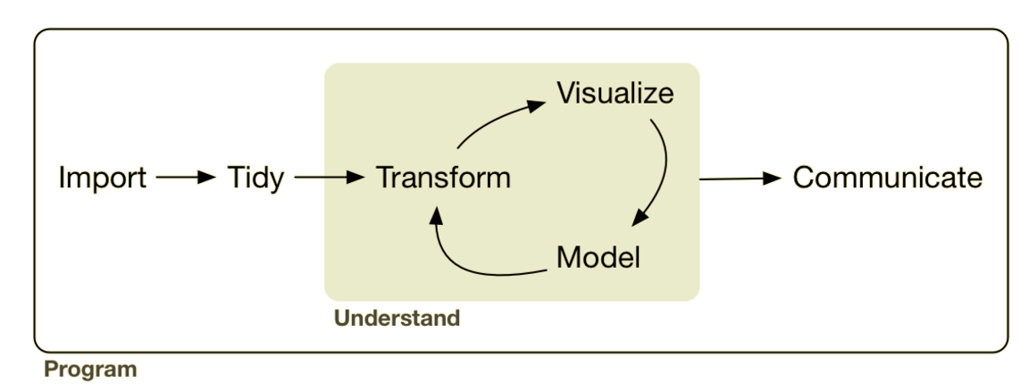
Analysis: Visualization Theory & Grammar
Lesson Objective: Select theory based geoms & aesthetics to represent data.
Notes:
We can use the tansforms to add summary representations to the visual. Adding this makes our visualizations more powerful because we can add more layers.

Slide 3




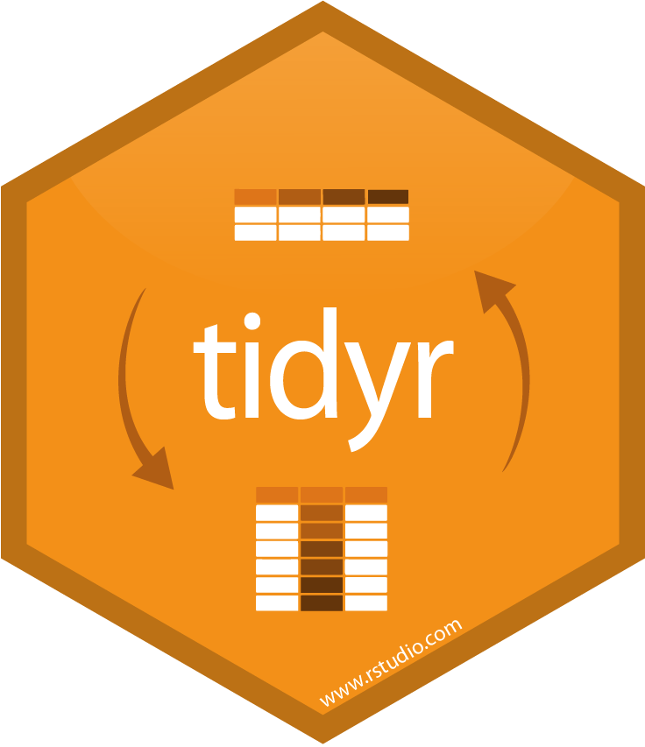
Analysis: Visualization Theory & Grammar
sql ops

Slide 4
Recap: ggplot2 boiler plate
Recap
ggplot(data = <DATA>) +
geom_<xxx>(mapping = aes(<MAPPINGS>))

Slide 5
Recap: ggplot2 boiler plate
Recap
ggplot(data = <DATA>) +
geom_<xxx>(mapping = aes(<MAPPINGS>))

Slide 6
Recap: ggplot2 boiler plate
Recap
ggplot(data = <DATA>) +
geom_<xxx>(mapping = aes(<MAPPINGS>)) +
geom_<xxx>(mapping = aes(<MAPPINGS>))

Slide 7
Recap: ggplot2 boiler plate
Recap
ggplot(data = <DATA>) +
geom_<xxx>(mapping = aes(<MAPPINGS>)) +
geom_<xxx>(data = <DATA>, mapping = aes(<MAPPINGS>))

Slide 8
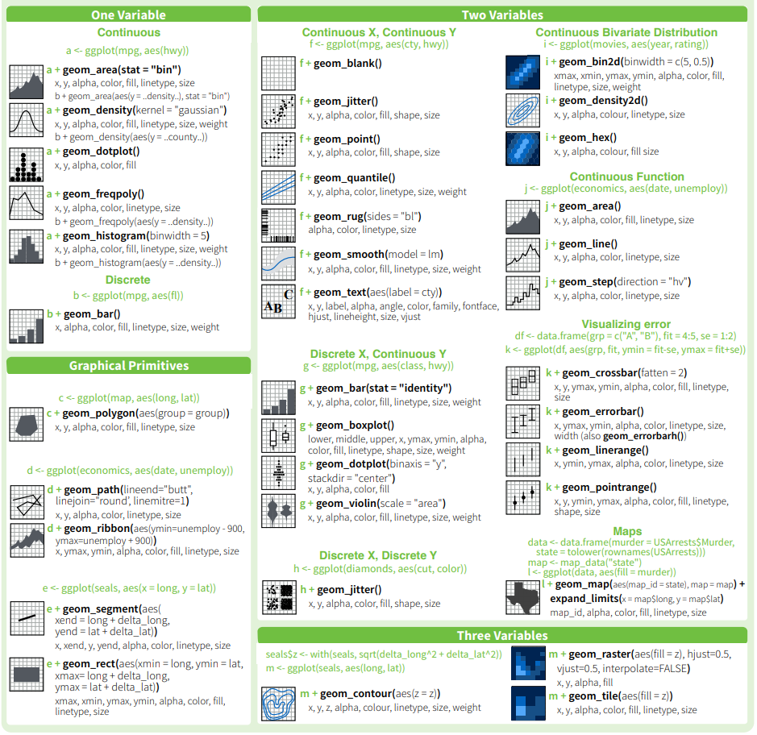
Recap: ggplot2 geoms
Recap
Geometric Shapes

Slide 9
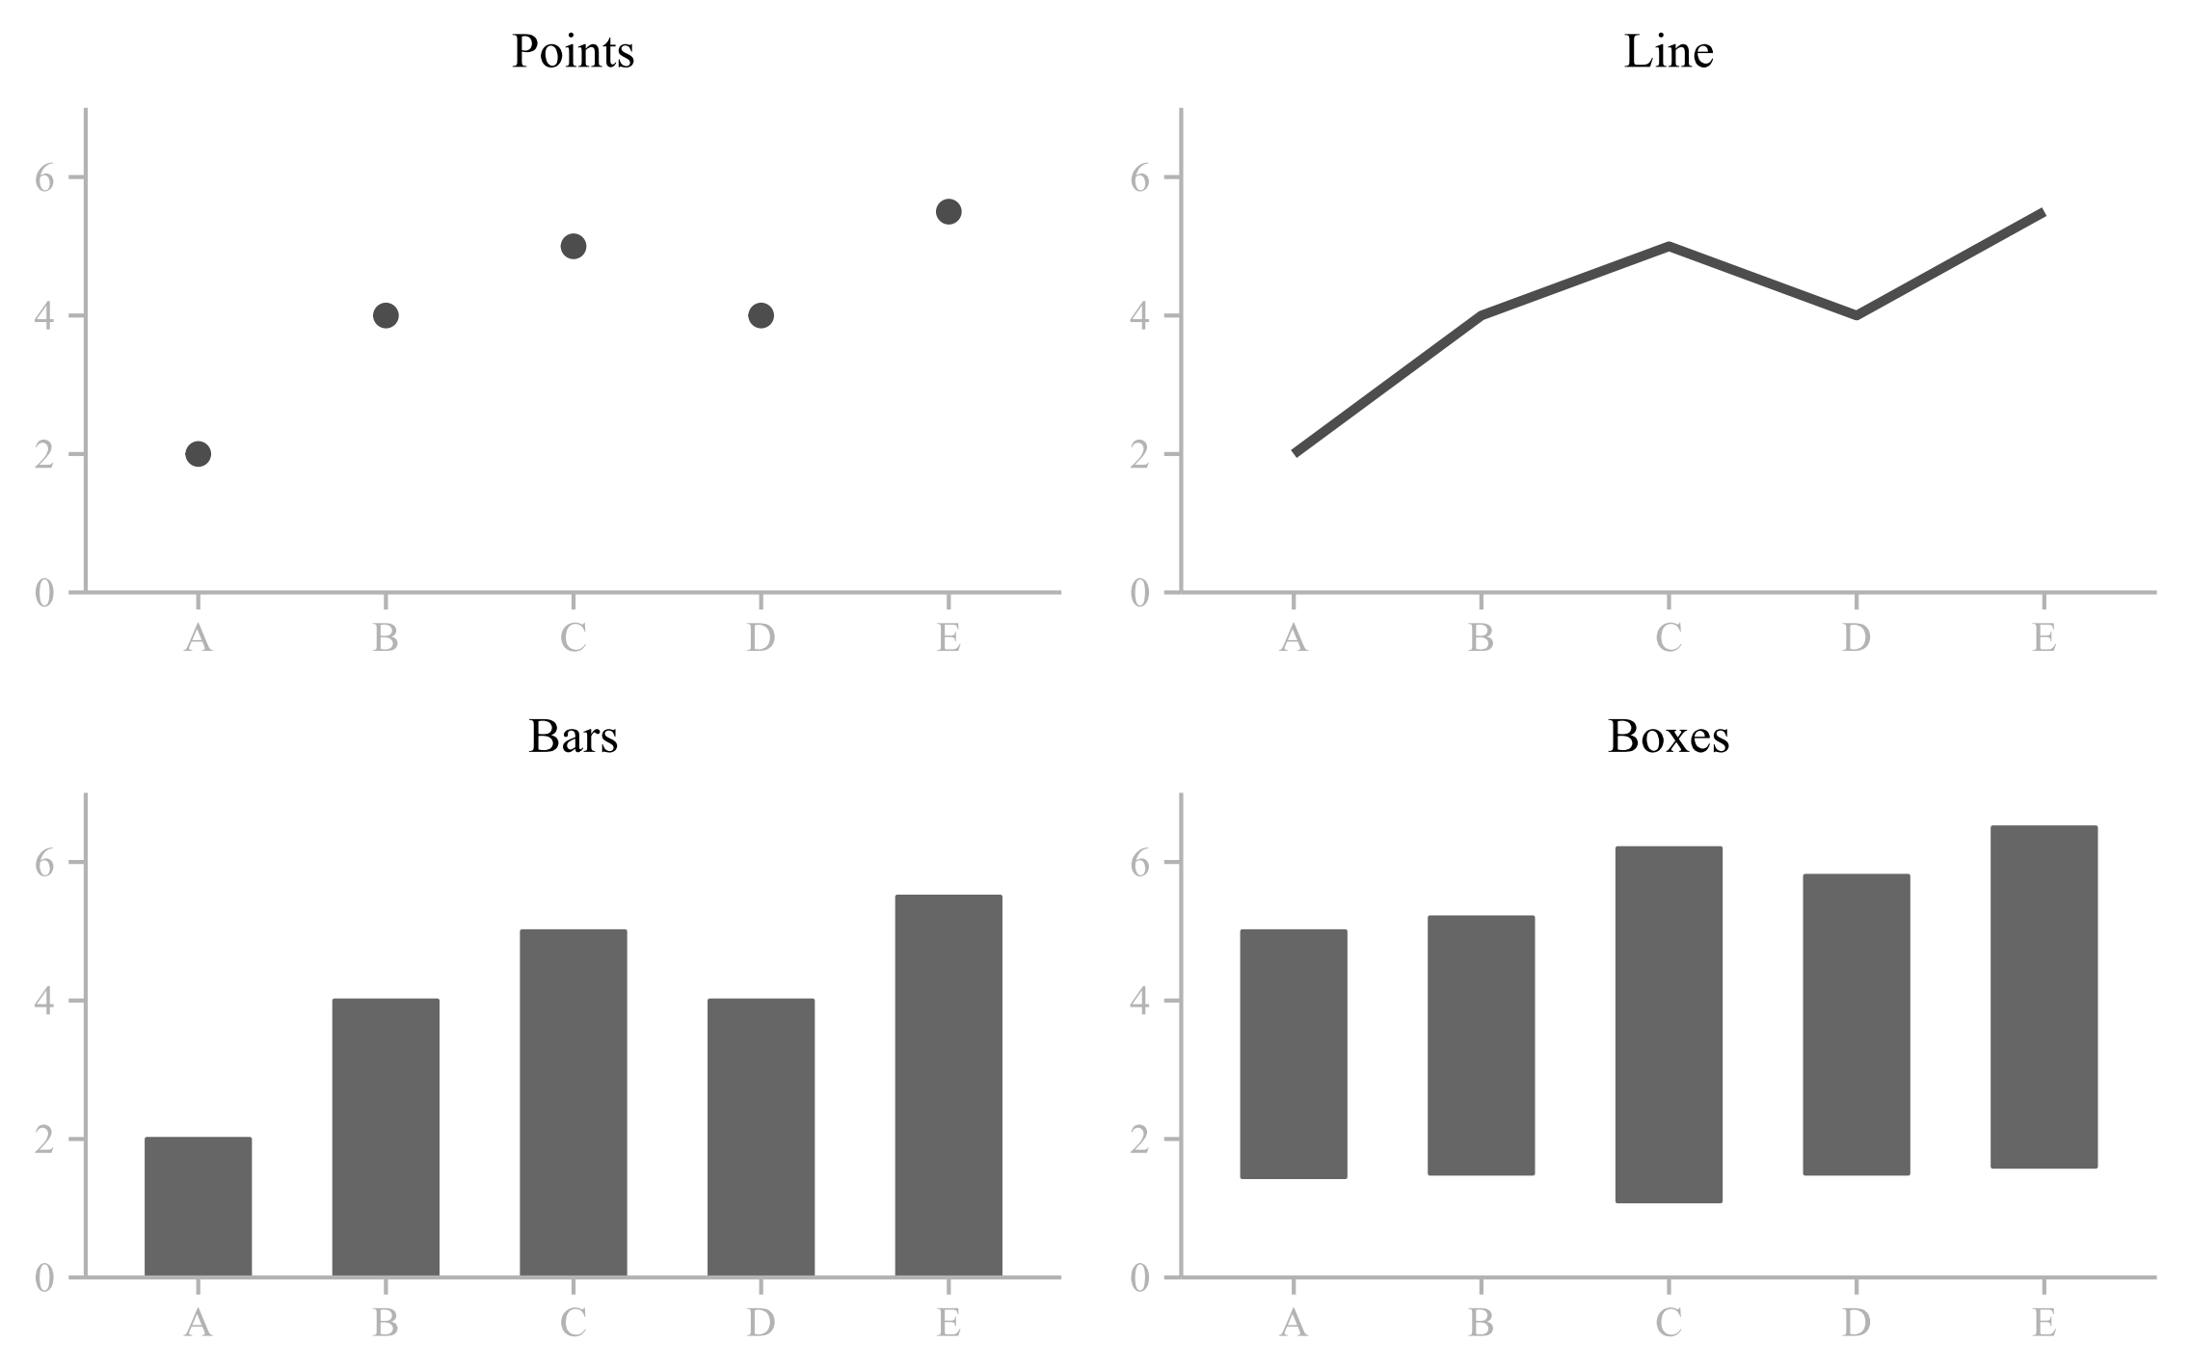
Recap: ggplot2 geoms (most of the time)
Recap

Slide 10
Recap: ggplot2 aes (Aesthetics)
Recap
point
shape
fill
stroke
position
(x & y)
alpha
size

Slide 11
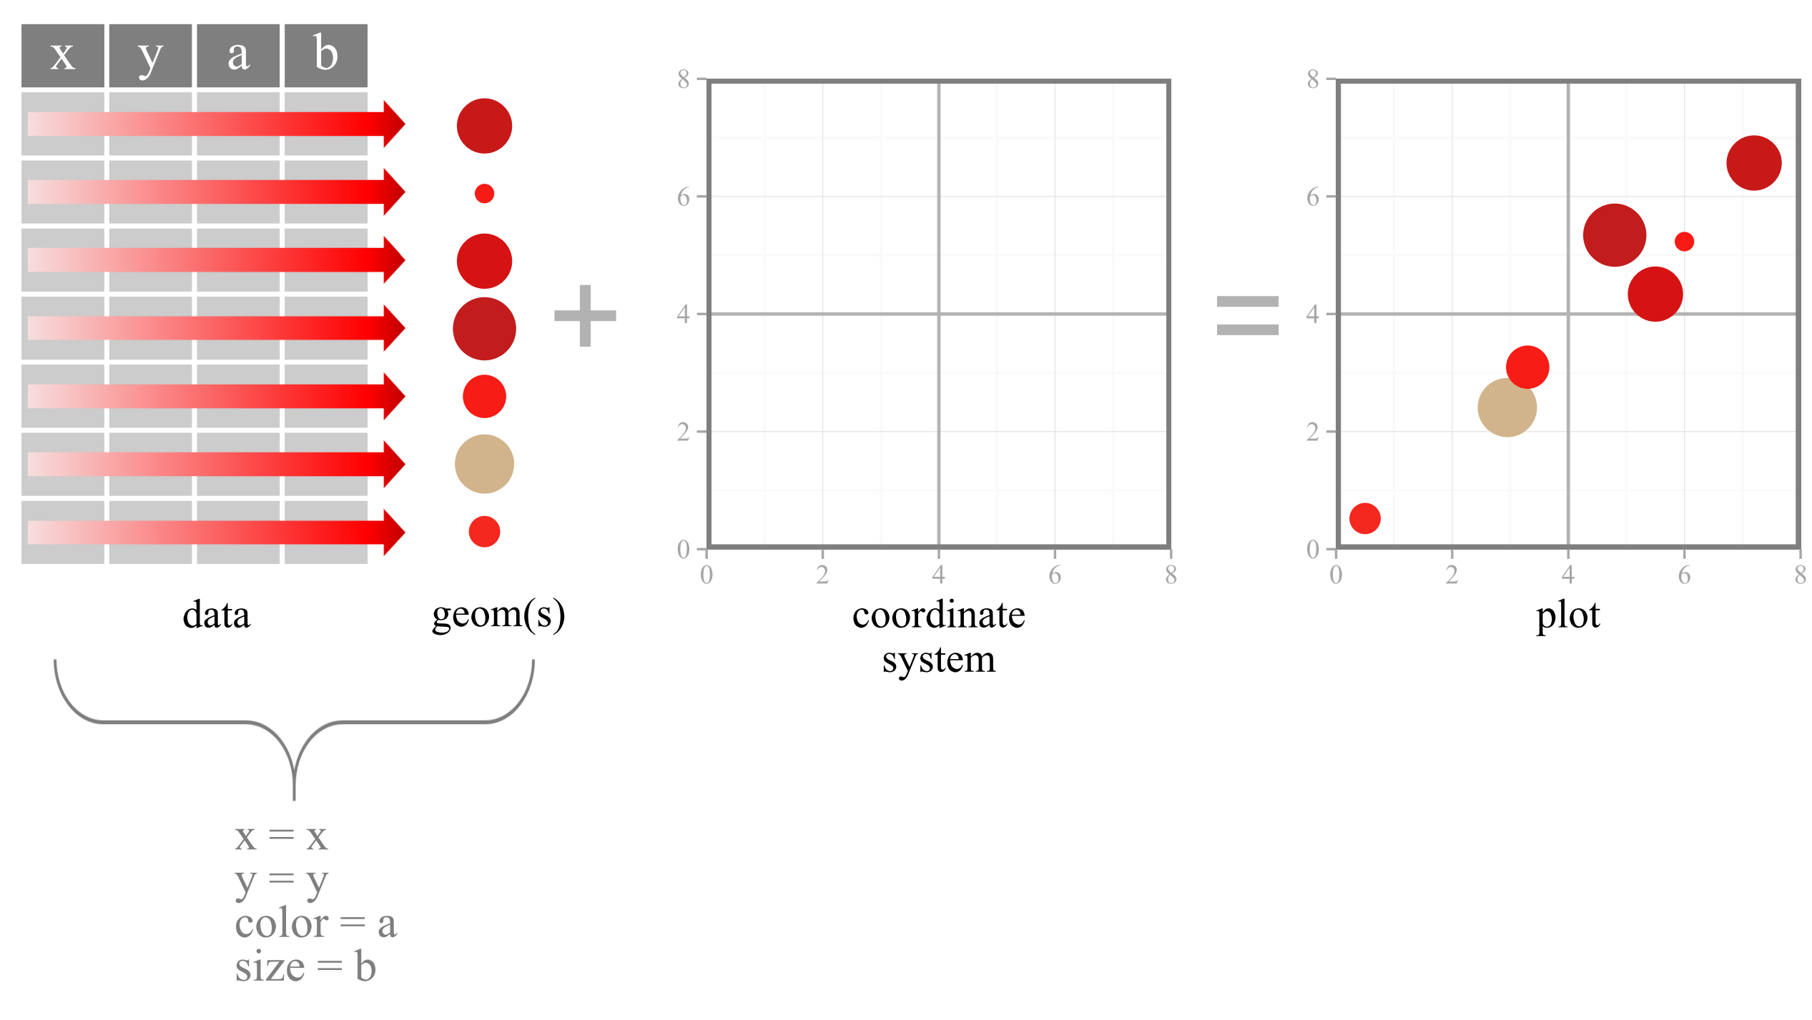
Recap: ggplot2 aesthetics (aes → variable)
Recap
aesthetics

Slide 12
Recap: ggplot2 aesthetics (aes → constant)
Recap
color = " blue "
aesthetics

Slide 13
Theory for Selecting Geoms & Mapping Aesthetics
This Session

Slide 14
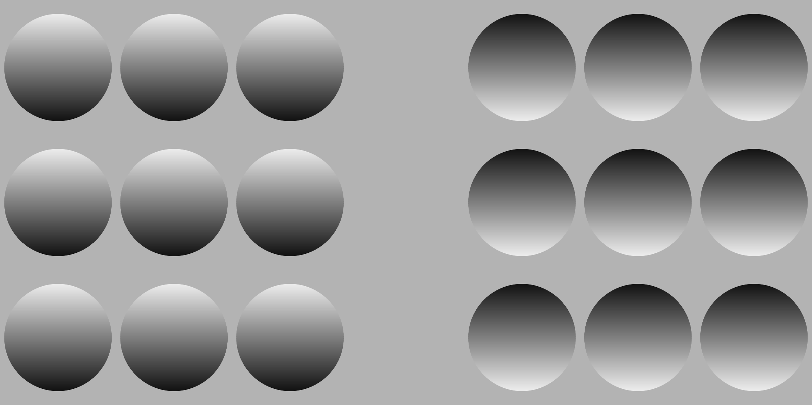
It is a science.
A
B
Visualization is not an art.
There are theoretical reasons in viz design.
Notes:
Which group is concave? Convex?

Slide 15
A
B
Notes:
How bout now? Why? We are wired in certain ways to see things visually. If you understand how we are wired we can take advantage of this to optimize our graph designs.

Slide 16

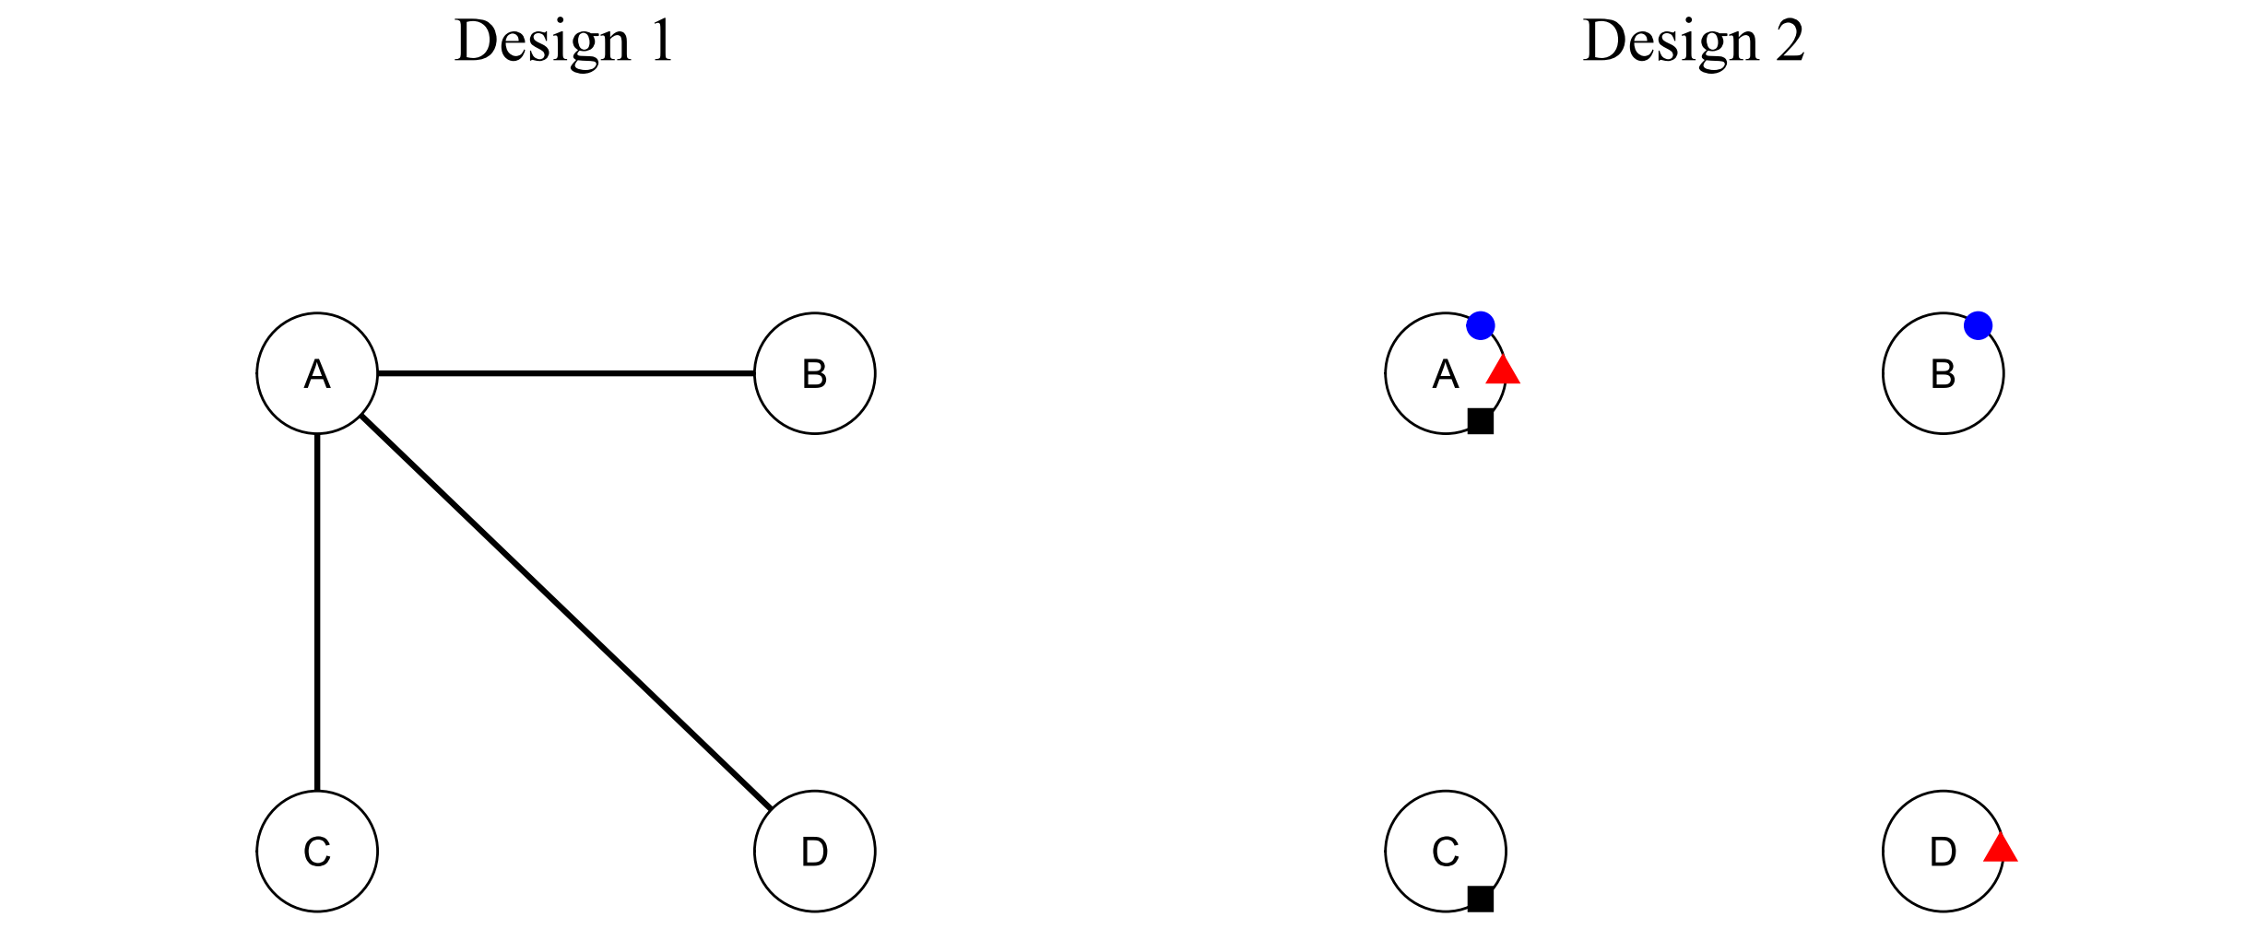
Fact: Not all design choices are equally good.

Slide 17
Pre-attenitve Attributes
Mantra: “Maximize Pre-attentive Attributes”

Slide 18
Three Design Principles
Maximize Pre-attentive Attributes
Minimize Cognitive Demand
Less is More
“Above all else show the data.” -Edward Tufte-

Slide 19
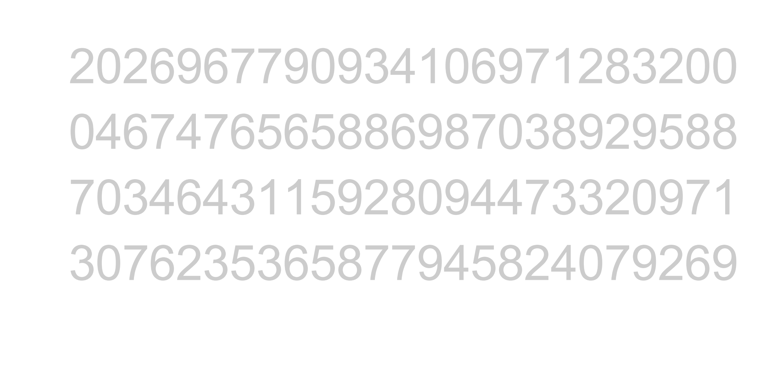
1. Maximize Pre-attentive Attributes
What’s a pre-attentive attribute anyway?
Count the number of twos

Slide 20
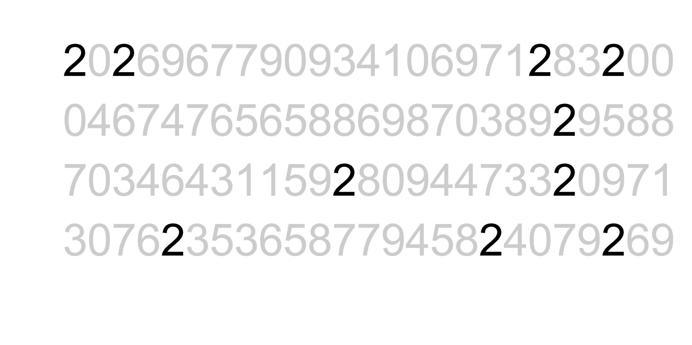
1. Maximize Pre-attentive Attributes
Count the number of twos

Slide 21
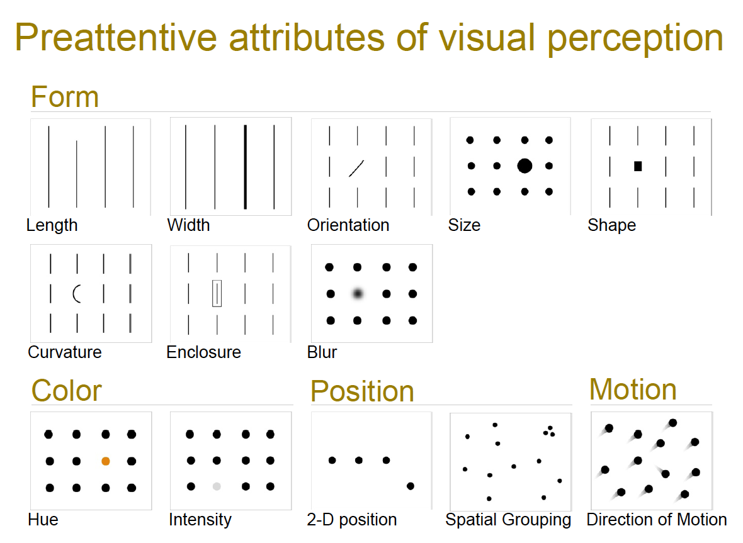

Slide 22
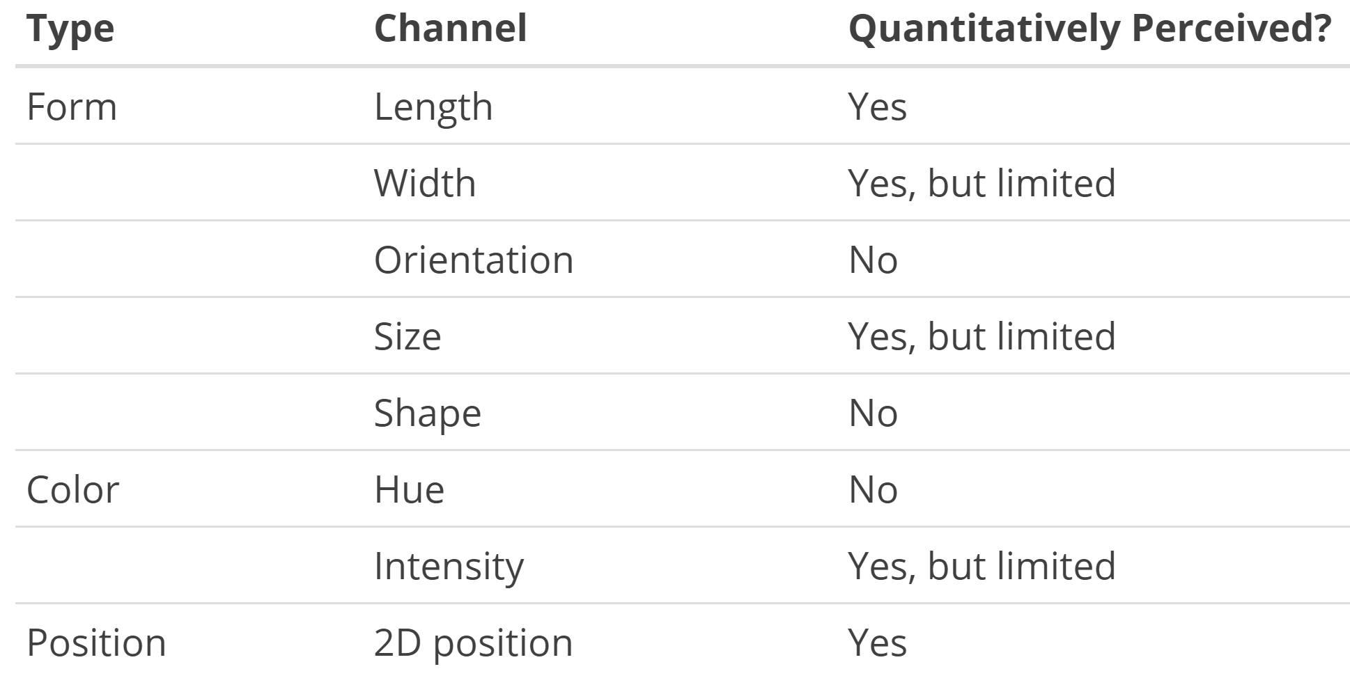

Slide 23
Quantitative Data?

Slide 24
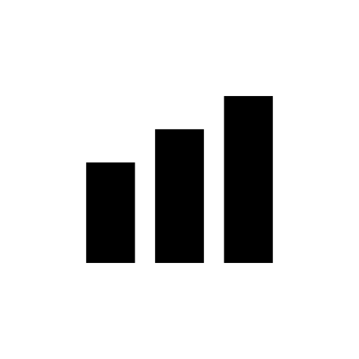
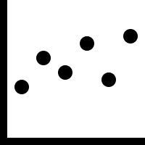


Quantitative Data?
Notes:
Selection of geoms

Slide 25
Categorical Data?

Slide 26
Categorical Data?
Notes:
Selection of geoms

Slide 27
Categorical Data?
Notes:
Selection of geoms

Slide 28

1. Maximize Pre-attentive Attributes
Hmm…

Slide 29
1. Maximize Pre-attentive Attributes
So we can map types of data to shapes and attributes…

Slide 30
1. Maximize Pre-attentive Attributes
This sounds familiar…

Slide 31
1. Maximize Pre-attentive Attributes
ggplot(data = <DATA>) +
geom_<xxx>(mapping = aes(<MAPPINGS>))

Slide 32
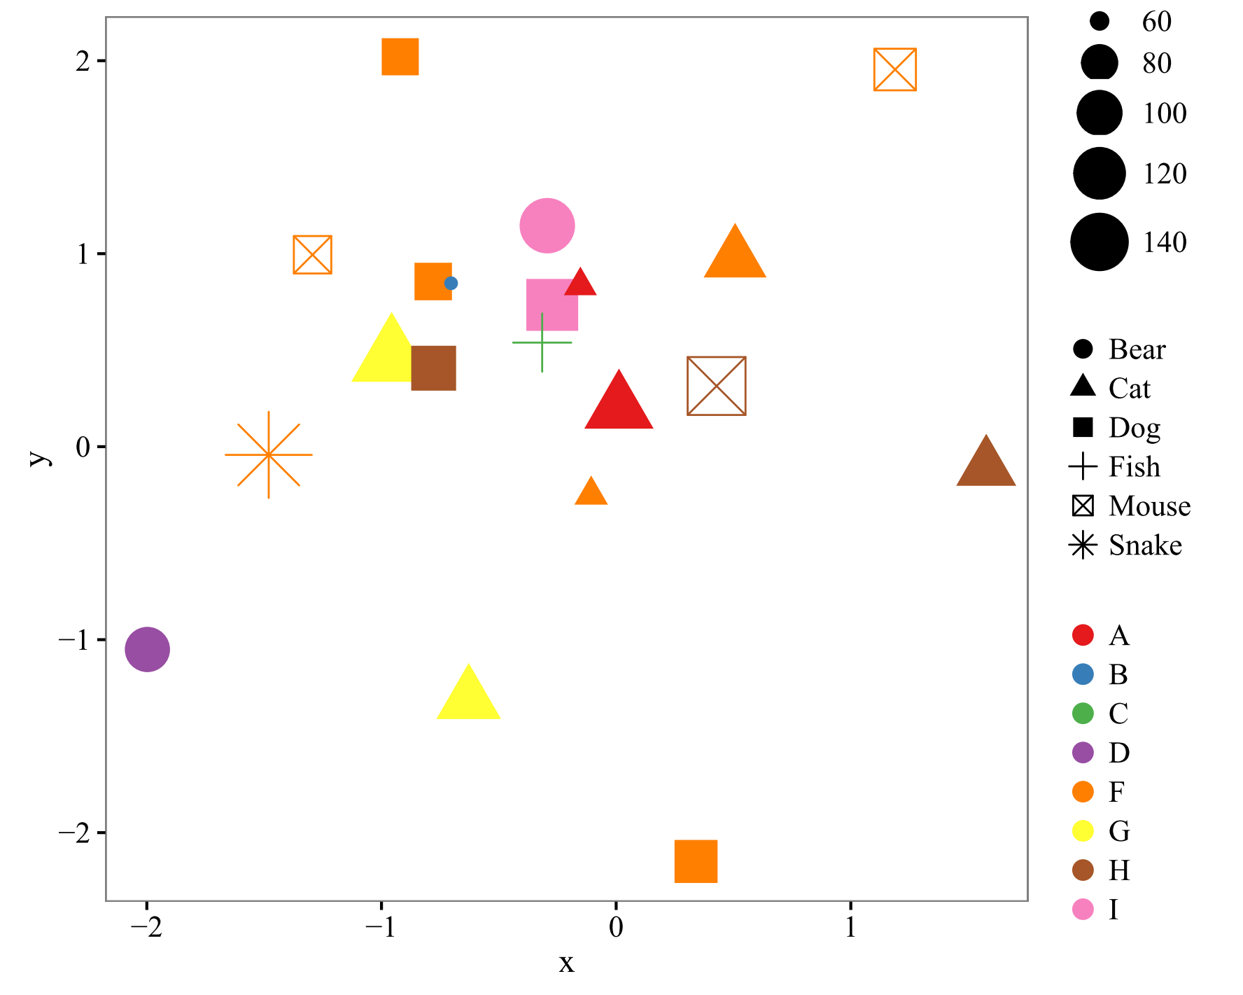

1. Maximize Pre-attentive Attributes
Maximize
Notes:
If you try to use too many preattentive attributes

Slide 33
2. Minimize Cognitive Demand
“The Magical Number Seven Plus or Minus Two”
-George Miller (1956)-

Slide 34
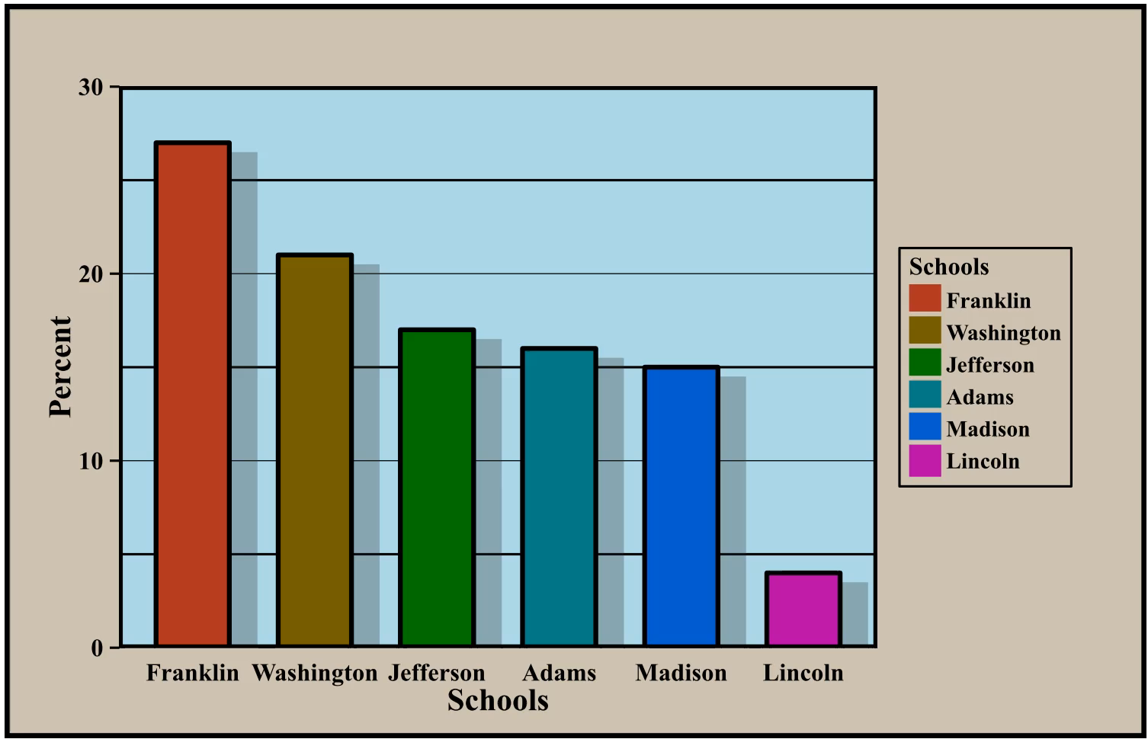
3. Less is More

Slide 35
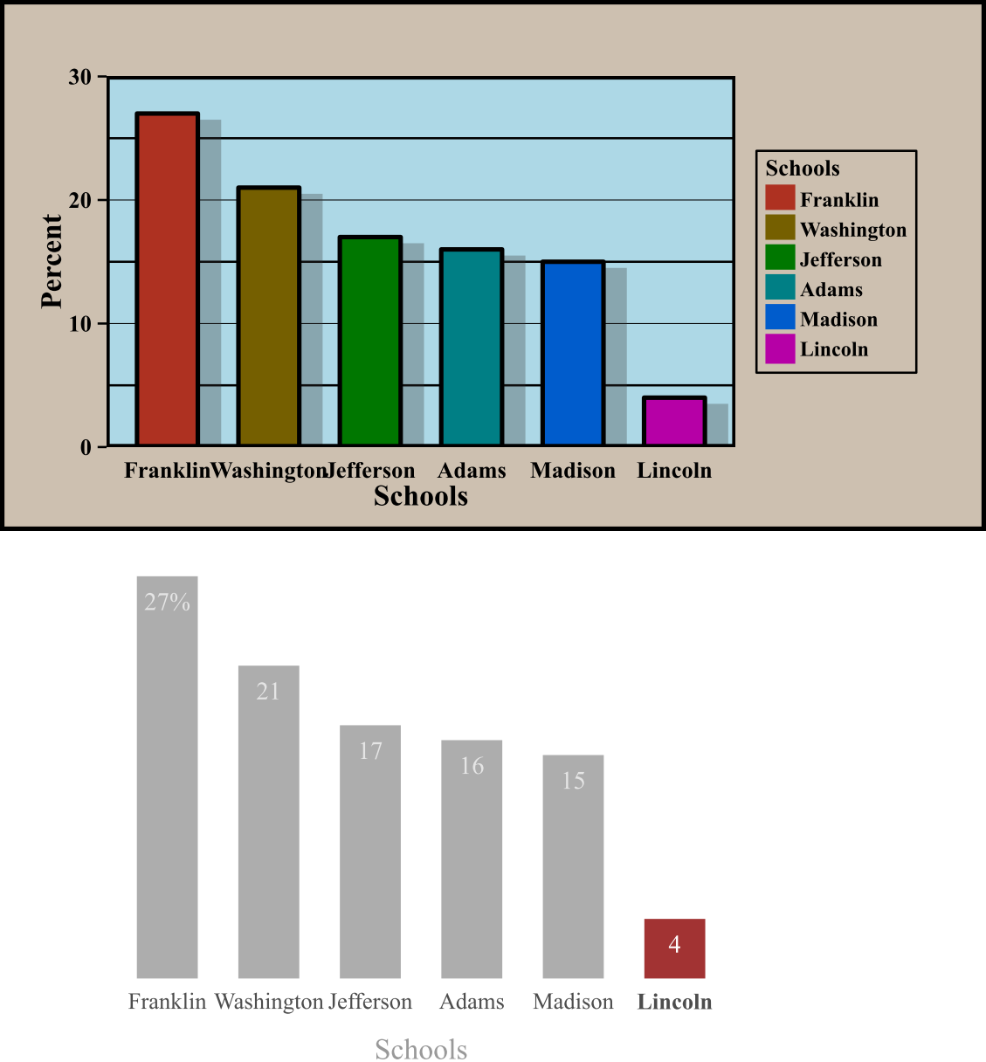
3. Less is More

Slide 36
Big Take Aways…
Data maps to pre-attentive attributes
ggplot2
Geom selection
Aesthetics mapping
ggplot(data = <DATA>) +
geom_<xxx>(mapping = aes(<MAPPINGS>))

Slide 37
Let’s Code!

Slide 38
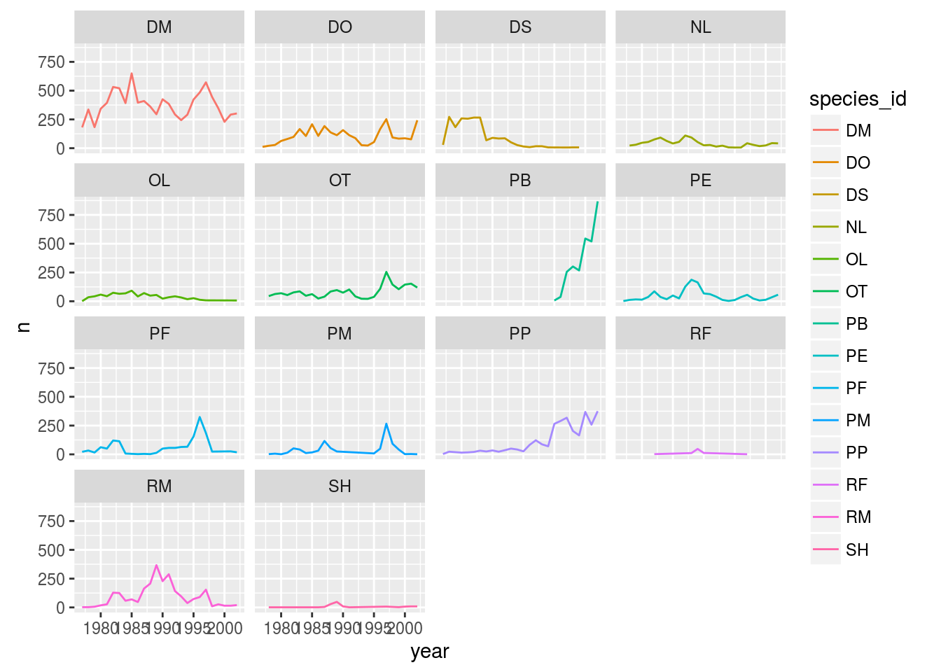
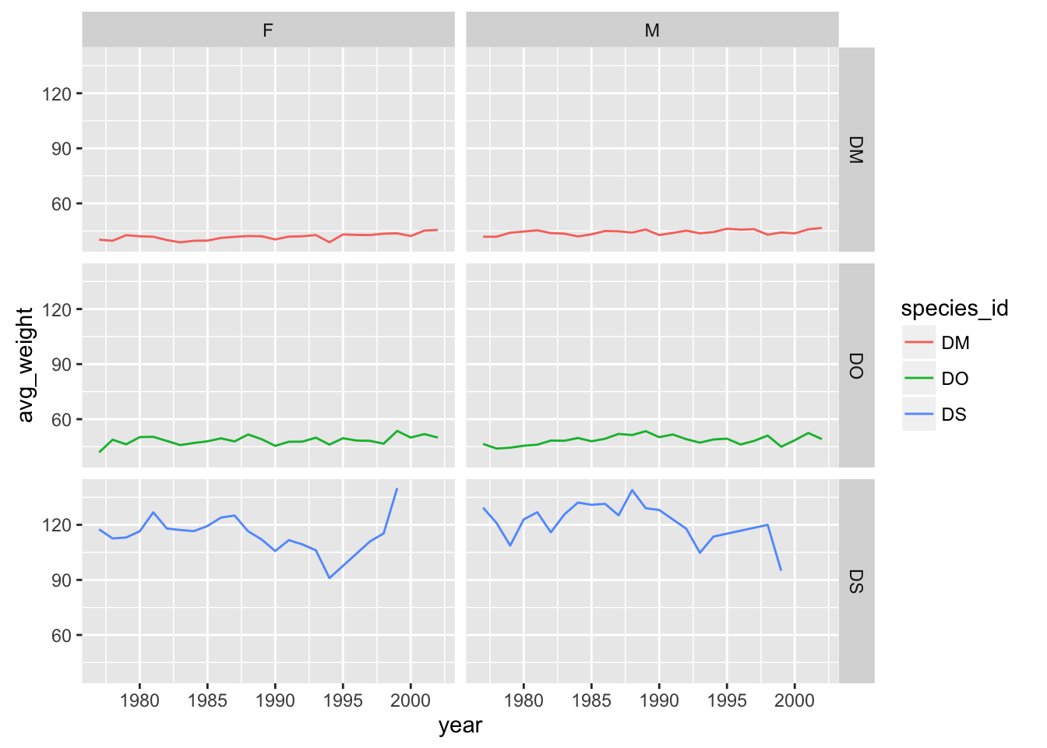
Facets
facet_wrap
facet_grid

Slide 39
Let’s Code!

Slide 40
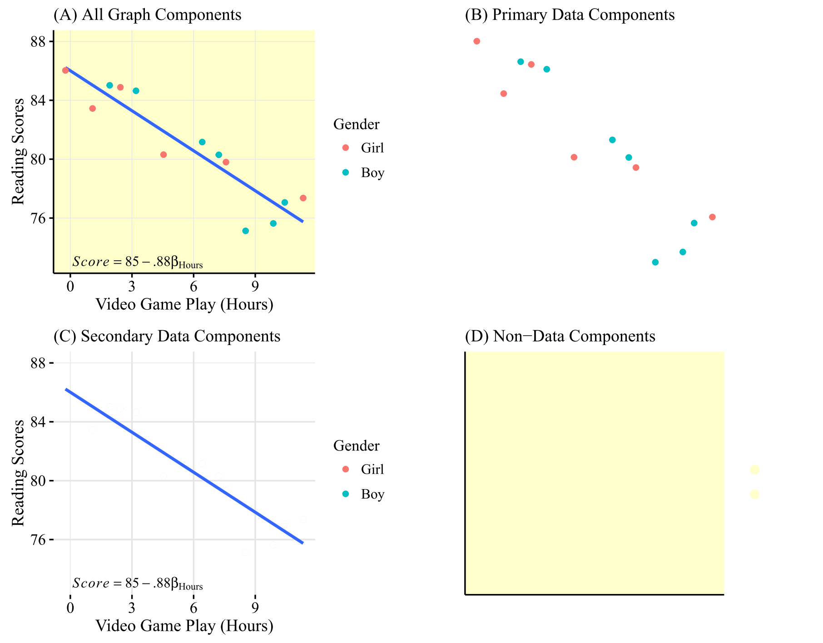
Viz Components
Primary focus:
Selecting geoms and mapping data to aesthetics for primary and secondary data components.
Notes:
Ggplot can handle all aspects of components but for the scope of this course we’ll stick to primary and geoms in the secondary

Slide 41
Let’s Code!

Slide 42

Selecting Geoms/Designs
Ok so there’s theory… help me know where to start.

Slide 43
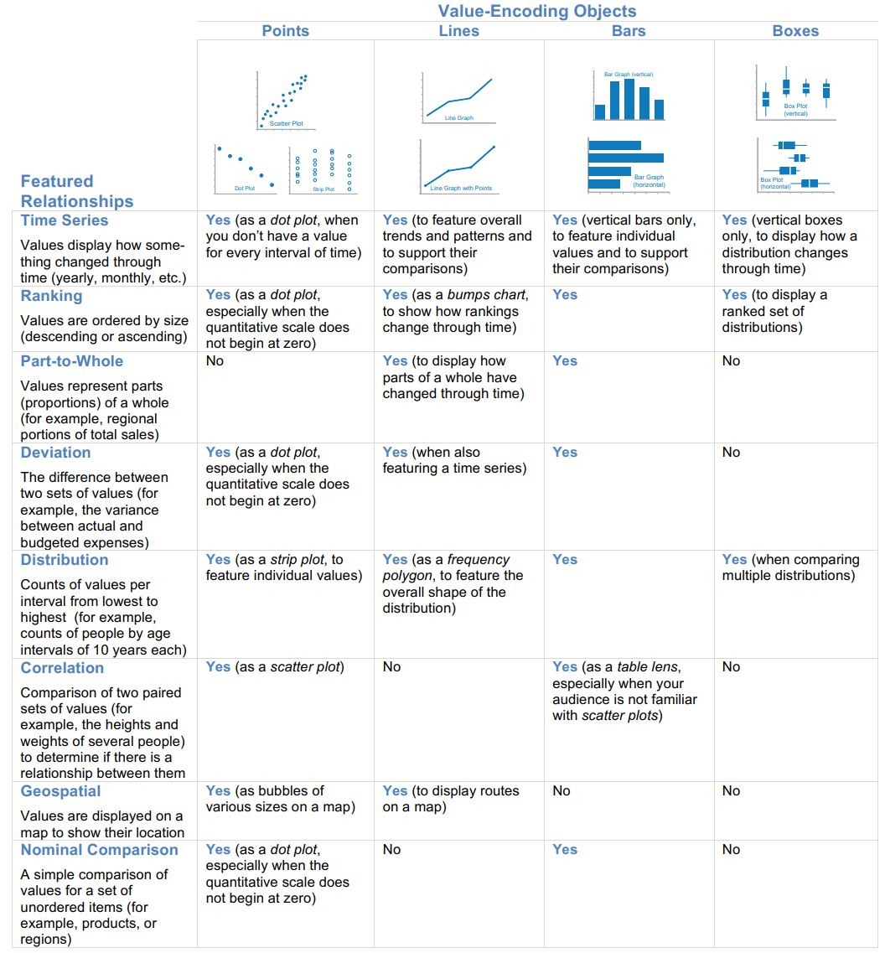
Few’s Graph Selection Matrix
What is the relationship you want to examine?

Slide 44
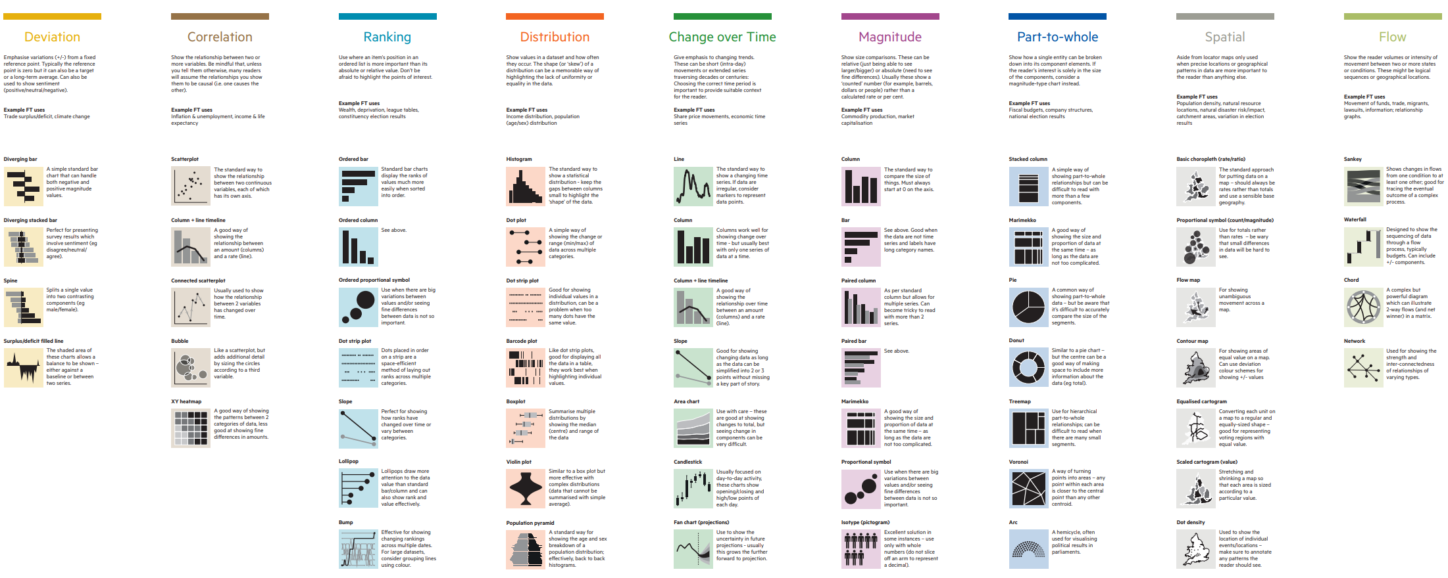
Financial Times Visual Vocabulary
What is the relationship you want to examine?

Slide 45
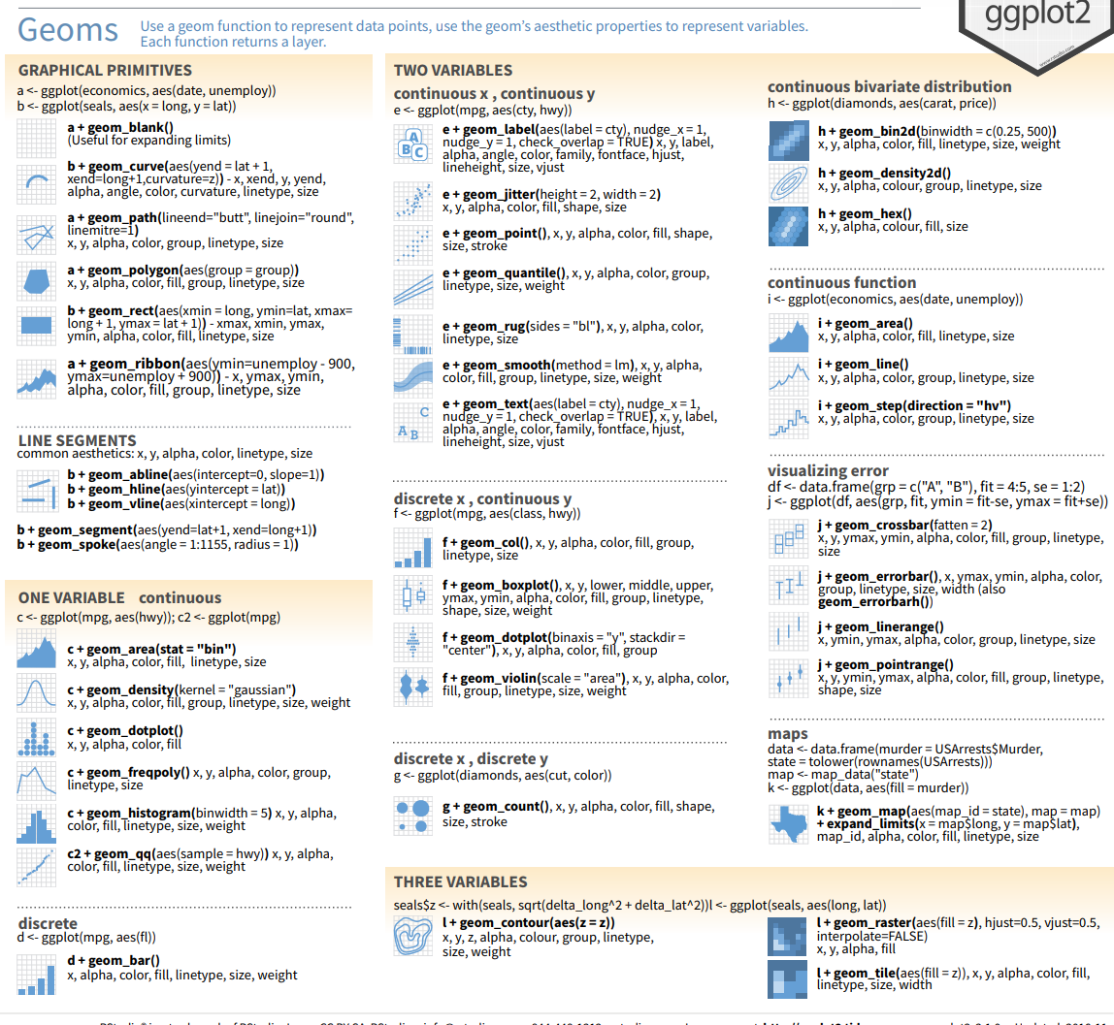
What are the geoms again?

Slide 46
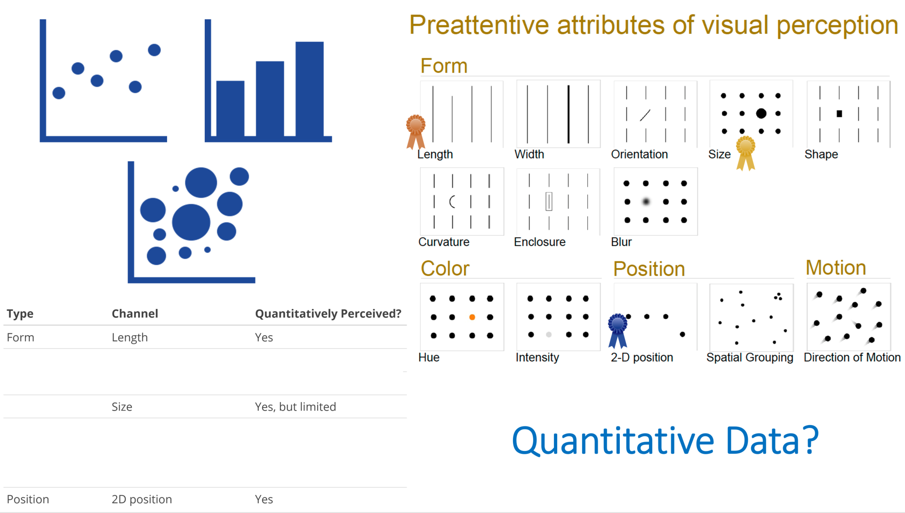
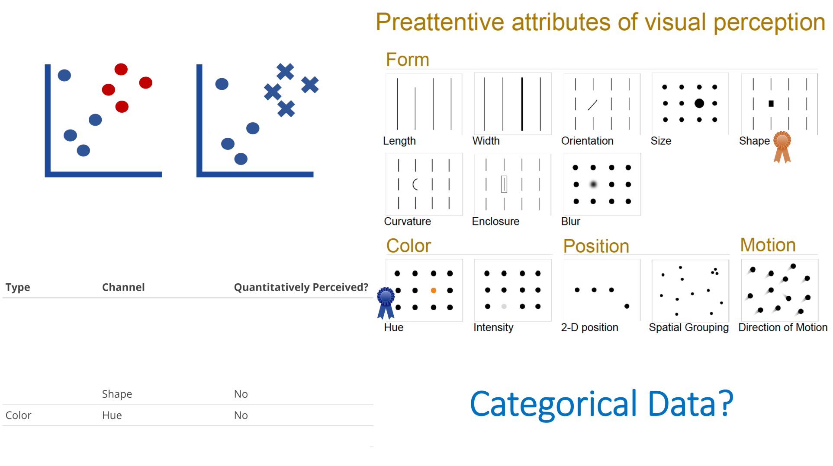
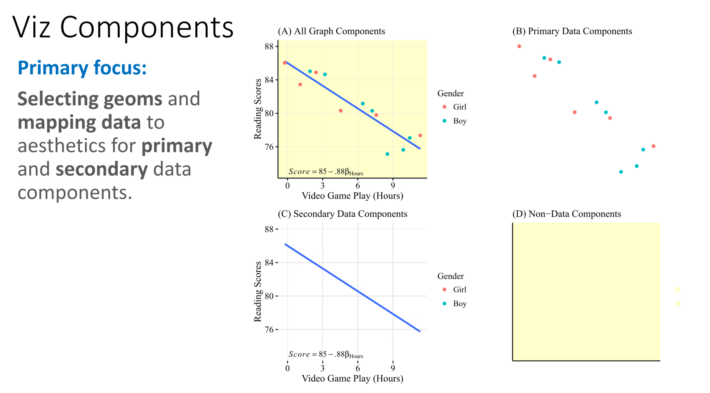
Recap Today
Let’s apply it.......

